Slide 1
Pricing and Model Validation
Kenneth C. Abbott
Managing Director
ken.abbott@barclays.com

Slide 2
Overview
Pricing
  Definitions
  Standards
  Tests
  Sources
Model validation
  Why have a policy?
  Model Committee
  What Is a Model Validation?
  Defined Responsibilities
  Storage and Cataloging

Slide 3
Pricing

Slide 4
P&L Measurement
What is P&L?
How frequently measured?
How is it “managed”?
How is it tracked?
Why is it error-prone?

Slide 5
P&L Measurement
What is P&L?
  MTM
  Accrual
  Interest
  Capital gains/losses
  HFS/AFS
  HTM
  Equity method

Slide 6
P&L Measurement
How frequently measured?
  Intraday
  Obviously, daily
  Monthly
  Quarterly
    Management
    Regulatory
  Annual
    Management
    Regulatory

Slide 7
P&L Measurement
How is it managed?
  Capital budgeting process
  Timing issues
  Trader smoothing
  Accounting issues
  Reg gaming

Slide 8
P&L Measurement
How is it tracked?
  Intraday
  Backtesting
  Formal reporting
  “Cleansed”
  Hypothetical

Slide 9
P&L Measurement
Why is it error prone?
  Human error
  Model error
  Systems failure
  Timing issues
  Nonlinearities
  Events

Slide 10
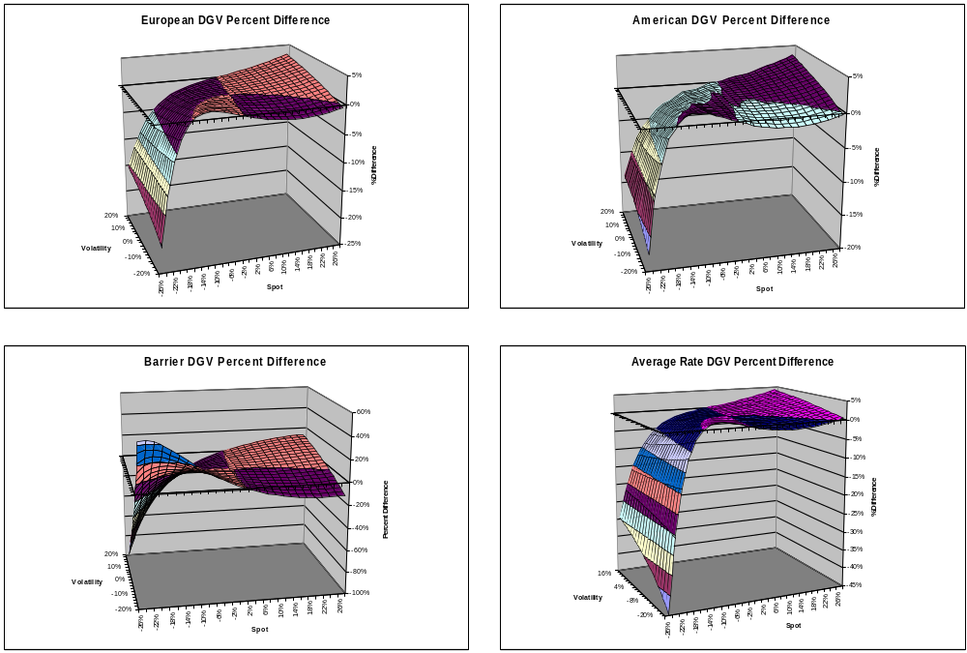
P&L Measurement
Heat Maps

Slide 11
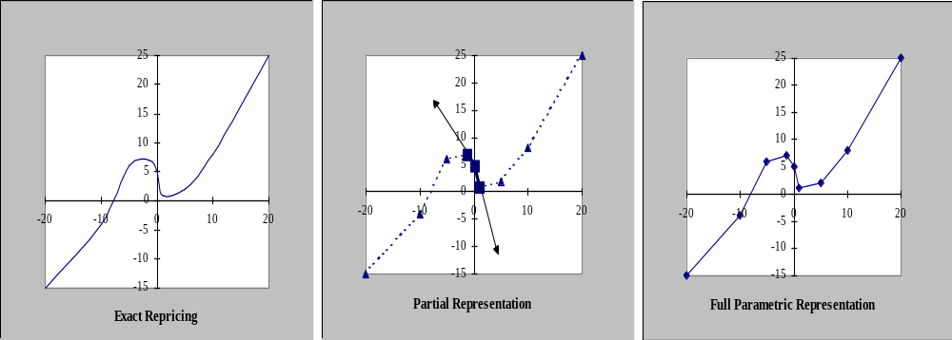
P&L Measurement

Slide 12
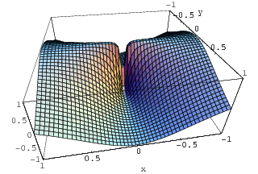
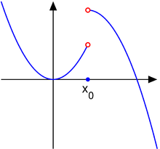
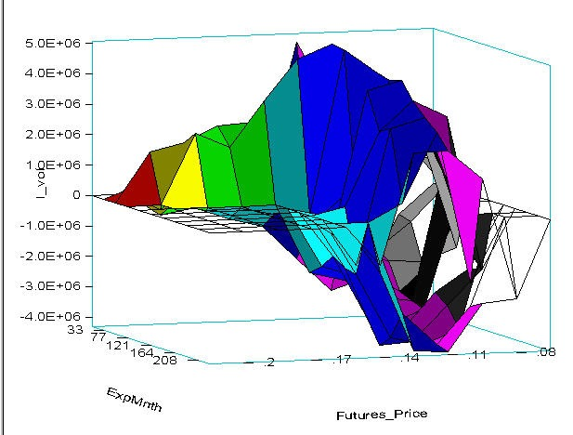
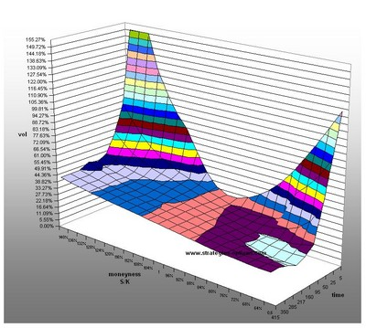
P&L Measurement

Slide 13
Fair Market Valuation
The price that an interested but not desperate buyer would be willing to pay and an interested but not desperate seller would be willing to accept on the open market assuming a reasonable period of time for an agreement to arise.

Slide 14
Arm’s Length Price
The price at which two unrelated and non-desperate parties would agree to a transaction.
This is most often an issue in the case of companies whose subsidiaries trade with each other.
For some companies, there is often an incentive to reduce overall tax burden by manipulation of inter-company prices.
Tax authorities want to insure that the inter-company price is equivalent to an arm's length price, to prevent the loss of tax revenue.

Slide 15
Fair Value
A) A valuation, in accordance with standard methodology, that is reasonable to all parties involved in a transaction in light of all pre-existing conditions and circumstances.
B) In the case of futures, the sum of the value of the underlying securities and the cost of carry (interest earned due to not holding the underlying minus dividends lost due to not holding the underlying).

Slide 16
Market Value/Price
A security's last reported sale price (if on an exchange) or its current bid and ask prices (if over-the-counter);
i.e. the price as determined dynamically by buyers and sellers in an open market. also called market price.

Slide 17
Independence
Is the person or persons marking the book (inputting or verifying FMV) economically neutral to the trade?
Does their get pay vary positively or negatively depending on whether the value of the trade increases or decreases?

Slide 18
Examples:
Traders are economically motivated to recognize profits early in the life-cycle of a trade
Portfolio managers are economically motivated to increased values at all points of the life-cycle.
Risk managers only benefit if corporation as a whole benefits

Slide 19
How to Prove that Prices are “Fair”?
Proof of security changing hands – transaction history
Consistency of valuation adjustments across input variables; credit spreads, tenors, issuer sectors etc.
Post-date review of MTM versus realized earnings

Slide 20
Model Tests
Purpose is to determine closeness-of-fit between model prices and empirically observed ones
Regression tests common
  Change of one variable at a time versus price change (often yields or market index levels)
Historical back-tests common
  Collect historic inputs, use model sequentially over periods of days to create model prices. Compare synthetic series to historic series.

Slide 21
Timing
Always a challenge at year end when European markets close a day earlier than US.
Also a problem when Chinese New Year / Golden Week (Japan) comes as many Asian markets close or reduce hours.
Generally cleanest to accept the P&L vol from timing mis-matches rather than justify adjustments…
Cash and futures markets close at different times of the day: when hedging cash (4:00pm close) with Eurofutures (3:30pm close) a late earnings announcement or news item can cause apparent hedge mismatch.

Slide 22
Reserves vs. “Adjustments”
Liquidity – mark to opposite side theoretically best.
Longs marked to the offer, shorts marked to the bid.
Alternatively, mark both sides to mid and take an average bid/offer spread as a “fair value adjustment.”

Slide 23
Size adjustments
Size – how big a discount is enough?
Hard to prove.
May use adjustment based on # of days of trading volume assuming you can trade 30%-50% of a day’s volume for a consecutive number of days.
For example – you have 5 days liquidity so takes 10-30 trading days to unwind. Vol = 25%*SQRT(30/260)=8.50%

Slide 24
Where to get Prices?
Bloomberg – also calculators and ALLQ
Markit, LPC, ILX, DRI etc. other pricing services
Prime Brokers
Custodians
Offshore administrators
External auditors

Slide 25
Levels 1-3
Level 1, 2, and 3 assets are ways of classifying a company's assets based on the degree of certainty around the assets' underlying value.
Level one assets can be valued with certainty because they are liquid and have clear market prices.
At the other end of the spectrum, Level 3 assets are illiquid and estimating their value requires inputs that are unobservable and reflect management assumptions.

Slide 26
Level 1
Financial assets and liabilities whose values are based on unadjusted, quoted prices for identical assets or liabilities in an active market
Examples include
  active exchange-traded equity securities
  listed derivatives
  most U.S. Government and agency securities
  sovereign government obligations
If you can look up an up-to-date price on a major exchange it's a level 1 asset.

Slide 27
Level 2
Assets / liabilities with values based on quoted prices in inactive markets, or on models - but with inputs that are observable either directly or indirectly
Level 2 inputs include the following:
  Quoted prices for similar assets or liabilities in active markets (for example, restricted stock);
  Quoted prices for identical or similar assets or liabilities in non-active markets (examples include corporate and municipal bonds, which trade infrequently);
  Pricing models whose inputs are observable for substantially the full term of the asset or liability (examples include most over-the-counter derivatives, including interest rate and currency swaps); and
  Pricing models whose inputs are derived principally from or corroborated by observable market data through correlation or other means for substantially the full term of the asset or liability
Examples include certain residential and commercial mortgage related assets, including loans, securities and derivatives).

Slide 28
Level 3
Financial assets and liabilities with values based on prices or valuation techniques that require inputs both unobservable and significant to overall fair value measurement.
These inputs reflect management’s own assumptions about the assumptions a market participant would use in pricing the asset or liability
Examples include
  certain private equity investments
  certain residential and commercial mortgage related assets (including loans, securities and derivatives)
  long-dated or complex derivatives including certain foreign stock exchanges, foreign options and long dated energy-related options
Level 3 assets trade infrequently, as a result there are not many reliable market prices for them.
Valuations of these assets are typically based on management assumptions or expectations.

Slide 29
Trading Book v. Banking Book
A key Basel issue
Possibility of capital arbitrage
Key determinants:
  Intent
  Pricing transparency
  Hedgability
  Liquidity
  Freedom from trading restrictions
Gray areas
Policy

Slide 30
Models

Slide 31
Why Worry About Models?
Model misspecification
Model mis-use
Hedge leakage
Sloppy implementation
Regulatory requirement

Slide 32
OCC 2000-16
“Model Validation” dated 5/30/2000
Initial attempt to define model best practice
Large impact on industry
Says that it is essential that banks develop formal policies to address model issues

Slide 33
OCC 2000-16
Major tenets
  General Procedures for Model Validation
    independent review of logical and conceptual soundness
    comparison against other models
    comparison of model predictions vs real-world events
  “Elements of Sound Validation Policy”
    Independent Review
    Defined Responsibility
    Model Documentation
    Ongoing Validation
    Audit Oversight

Slide 34
OCC 2000-16
  Validating the Model Inputs Component
    Data
    Assumptions
  Validating the Model Processing Component
    Code and Mathematics
  Model reports

Slide 35
OCC 2000-16
  “Summary of Supervisory Expectations”
    Decision-makers understand meaning /limitations of model results
    Testing against actual results
    Seniority of oversight commensurate with risk
    Validation independent of construction
    Responsibilities clearly defined
    Change control procedures in place

Slide 36
Model Committee
Crucial to the process
Membership:
  Risk, Ops, Finance, IT, quants
  Audit, Credit, BU
Regular formal meetings with set agendas
Good communication between meetings

Slide 37
What Is A Model Validation?
Executive Summary
White Paper / Bibliography
Technical Specification
Critique of Technical Specification
Testing (Includes stress testing & Greeks)
Approvals
Appendices

Slide 38
Defined Responsibilities
Model Committee
  policy
  people
  upgrading
  exec summaries
  central archive
  validators
  legacy models

Slide 39
Defined Responsibilities
Risk
  coordinates control groups
  reviews and approves suitability
  determine and reporting impact
  reviews & coordinate proposed implementation
  determines when additional docs are required
Finance
  Work with Risk, Ops and IT on implementation
  Identify Price Verification requirements
  Determines required change in reported P&L and any associated reserves.

Slide 40
Defined Responsibilities
Quants
  Provide documentation & testing
  Documents any caveats
  Provides additional expertise on conceptual approach or computational processing.
IT
  Maintains adequate change control procedures.
  Performs routine QA on affected systems.
  Maintains adequate test environment
  Coordinates implementation and roll out
  Keeps secured copies of code (both most recent and earlier versions) residing in core systems

Slide 41
Storage, Cataloging / Taxonomy
Two distinct processes
Storage
  format (.pdf, .doc)
  medium (network, www, CD, etc.)
Cataloging/Taxonomy
  “market models” vs “payoff models”
  need to keep track of updates, reviewer, model type, issues, status
  format

Slide 42
Fed Model Standards

Slide 43
Federal Reserve Model Standards
ID of models needing validation
  Formal process needed
  Inventory needed (with status)
  Roles and responsibilities need to be defined
  Model changes requiring review need tracking
Independence
  Need technical expertise
  Need to be clear about extent to which reviewers rely on developers
Prioritization
  Prioritize by riskiness
  Quantitative and qualitative risks
  Need adequate resources
  Progress needs to be tracked
  Need formal criteria for review

Slide 44
Federal Reserve Model Standards
Rigor of Review
  Justification of rigor “appropriate to complexity of model”
  Reviewer expertise appropriate to complexity of model
  Clear documentation
  Ability to reproduce results from model docs
  Identification of assumptions
  Identification of deficiencies
  Distributional assumptions
  Necessity of reserves
  Independent testing
  Stress testing with range of inputs
  Check prices with outside source
  Backtesting of risk models
  Testing of implementation in environment consistent with use

Slide 45
Federal Reserve Model Standards
Approval Process
  Review and approval process needs to keep up with pace of model development
  Need for compensating controls in absence of full validation: limits, reserves
  Each control function to sign off
  Need clear policy and procedure on models
  Reserve methodology relevant and prudent
Ongoing Validation
  Check for continued appropriateness
  Continuous assessment of changes that affect the model
  Periodic review
  Appropriateness of current level of model reserves

Slide 46
Federal Reserve Model Standards
Other issues
  Vendor models
    Need review also
    Recognition that documentation may be limited
  Pre-validation
    Desirable, but not always possible
    Compensating controls necessary
  Internal Audit role
    OK to use outside validators
    Audit needs to have a role in overall process

Slide 47
OCC 2011-12 Fed SR 11-7

Slide 48
Executive Summary
The OCC and Fed jointly issued supervisory guidance to govern management of model risk
“Supervisory Guidance on Model Risk Management”, outlines elements effective model risk management and
details prudent risk management practices related to
  “effective challenge” of models through model validation,
  strong governance,
  internal audit coverage,
  clear internal policies and
  documentation.
Banks expected to ensure model risk management policies, procedures, practices consistent with the new Guidance,

Slide 49
Executive Summary
The Guidance was released by the OCC through Bulletin 2011-12 and by the Fed through SR Letter 11-07.
Both documents were released on April 4, 2011.
They apply to
  national banks,
  bank holding companies,
  state member banks and
  all other institutions for which the OCC or Fed is the primary supervisor

Slide 50
Background
Designed to clarify / supplement OCC 2000-16
The OCC and Fed note that Banks routinely use models for a broad range of activities, including:
  underwriting credit;
  valuing exposures, instruments, and positions;
  measuring risk;
  managing and safeguarding client assets; and,
  determining capital and reserve adequacy.

Slide 51
Background
Banks have applied models to more complex products and with more ambitious scope
Changes in regulation, particularly new reg cap rules for market, credit and op risk have also spurred the more recent model usages.
Agencies acknowledge that models can improve business decisions but caution they also impose risk from models that are either incorrect or misused.
Model risk increases potential for poor business /strategic decisions, financial losses, or damage to reputation.
Guidance based on premise that model risk to be managed like other risks, with consideration to the risk from individual models and models in the aggregate.

Slide 52
Definition: Model
A quantitative method, system, or approach that applies statistical, economic, financial, or mathematical theories, techniques, and assumptions to process input data into quantitative estimates.
It consists of three components:
  Information inputs, which deliver assumptions and data to the model;
  Processing, which transforms the inputs into estimates; and ·
  Reporting, which translates estimates into useful business information.
The definition of “model” also covers quantitative approaches whose inputs are partially or wholly qualitative or based on expert judgment, provided that the output is quantitative in nature.

Slide 53
Definition: Model Risk
potential for adverse consequences from decisions based on incorrect or misused model outputs and reports.
caused by fundamental errors, such as erroneous application of calculations and theories or erroneous assumptions, as well as by use inconsistent with design
increases with model complexity, degree of uncertainty about inputs or assumptions, breadth of use, and potential impact.
can be evaluated at the individual model level but also in the aggregate, where it is affected by the interaction and interdependency among models and the commonality of assumptions, methodologies and data inputs.

Slide 54
Definition: Effective Challenge
“Effective challenge” is the result of critical analysis of a model by objective, competent parties who can identify the model’s limitations and effect changes.
Model quality can be measured in many ways including, among others: precision, accuracy, discriminatory power, robustness, stability, and reliability.
Models are never perfect, and the appropriate metrics of quality and the effort that should be put into improving quality, depend on the situation.

Slide 55
Scope
The Guidance states that model risk management framework should be more extensive and rigorous where models and model outputs have a material impact on business decisions, including decisions
  risk management
  capital planning
  liquidity planning,
  wherever model failure would have a particularly harmful impact on a Bank’s financial condition.

Slide 56
Model Risk Management
Model risk management includes:
Model development
Model implementation,
Model use;
Model validation
Governance and Control Mechanisms.

Slide 57
Model Development, Implementation and Use
Because models are employed in the real world they should be tailored for specific applications and informed by business uses.
An effective development /implementation process requires
  A clear statement of purpose.
  Documentation of underlying theory and logic, supported by published research and sound industry practices, supplemented by comparisons with alternative theories and approaches.
  Rigorous assessment and documentation of data quality / relevance.
  Tracking and analysis of assumptions made to adjust the data, especially with respect to new products, instruments or activities.

Slide 58
Model Development, Implementation and Use
  Testing for accuracy, limitations, and behavior under actual circumstances for a variety of market conditions, including scenarios beyond ordinary conditions.
  Proper coordination with the capabilities and requirements of supporting information systems.
  Solicitations for suggestions and criticisms of the model’s outcomes from sources independent of the business line using the model.
  Demonstration that the Bank is accounting for model uncertainty and inaccuracy (quantitative and/or qualitative).
  Justification and substantiation of claims that the model is conservative

Slide 59
Smaller Banks
Smaller banks that rely on vendor models may be able to satisfy the standards in the Guidance without an in-house staff of technical, quantitative model developers.
However, even if a Bank relies on vendors for basic model development, the Bank should choose the models and variables that are appropriate to its size, scale, and lines of business and ensure the models are appropriate for the intended use.

Slide 60
Model Validation
The set of processes and activities intended to verify that models performing as expected, in line with their design objectives and business uses.
ensures models are sound, identifies potential limitations in assumptions, and assesses their possible impact.
To ensure effective challenge, model validation should be
  performed by staff with appropriate incentives (i.e., no vested interest in the validity of the model),
  competence (high level of technical expertise, familiarity with the line of business using the model),
  influence (explicit authority tochallenge developers and ensure issues and deficiencies are addressed in a timely and substantial manner).

Slide 61
Model Validation
All model components, including input, processing, and reporting, should be subject to validation.
The requirement should be applied equally to models developed in- house and to those purchased from or developed by vendors or consultants.
The rigor /sophistication of validation should be commensurate with
  Bank’s overall use of models,
  the complexity of models
  materiality of its models,
  size and complexity of the bank’s operations.

Slide 62
Effective Validation Framework
Evaluation of conceptual soundness, including developmental evidence
Ongoing monitoring: process verification and benchmarking to evaluate if changes in products, exposures, activities, clients, or markets necessitate adjustment and whether any extension of the model beyond its original scope is valid.
Monitoring should be periodic and regular, consistent with nature of model, availability of new data or modeling approaches, size of risk.
Overrides should be interpreted as an indicator that the model may need revision, and should be tracked and analyzed.
· Benchmark models should be rigorous and benchmark data should be accurate and complete.
3) Outcomes analysis, including a comparison of model output with actual outcomes.

Slide 63
Validation of Vendor and Third-Party Products
Vendor products should be incorporated into model risk management framework using the same principles as applied to in-house models. Vendors should:
  Provide developmental evidence explaining the product components, design, and intended use.
  Provide appropriate testing results.
  Evaluate and provide the model’s limitations and assumptions.
  Conduct ongoing performance monitoring /outcomes analysis and provide disclosure to clients, making appropriate modifications
Banks should:
  Validate their use of the vendor products.
  Conduct ongoing monitoring and outcomes analysis of vendor model performance using the bank’s own outcomes.
  Have contingency plans for instances when the vendor model is no longer available or cannot be supported by the vendor.

Slide 64
Governance
Governance and control mechanisms for model risk management should set an effective framework with defined roles and responsibilities for clear communication of model limitations and assumptions, as well as the authority to restrict model usage.
The extent and sophistication of a Bank’s governance function is expected to align with the extent and sophistication of model usage

Slide 65
Board of Directors / Senior Management
The board of directors and senior management should establish a Bank-wide approach to model risk management also incorporated into the broader risk framework
The model risk framework should include standards for model development, implementation, use, and validation.
Duties of senior management include:
  establishing adequate policies and procedures, ensuring compliance
  assigning competent staff;
  overseeing development and implementation; evaluating results;
  ensuring effective challenge;
  reviewing validation and internal audit findings,
  taking prompt remedial action when necessary;
  regularly reporting to the board on significant model risk for individual models and in the aggregate.

Slide 66
Policies and Procedures
Model risk management activities should be formalized with policies and procedures to implement them, including
  prioritization, scope, and frequency of validation activities,
  detailed documentation of all aspects of the model risk management framework, including an inventory of models in use, results of the modeling and validation processes, and model issues and their resolution.
Roles and responsibilities are key
The roles in model risk management can be divided among ownership, controls, and compliance, while reporting lines should be clear and potential conflicts of interest identified.

Slide 67
Role of Audit
The role of internal audit is to evaluate the overall effectiveness of the model risk management framework
This includes
  the framework’s ability to address model risk from fundamental errors and incorrect usage,
  assessment of whether model risk management is comprehensive, rigorous, and effective.
Fed /OCC test Audit role very carefully

Slide 68
Model Inventory
Banks should maintain a comprehensive set of information for models in use, under development, or recently retired.
Any variation of a model that warrants a separate validation should be included as a separate model and cross- referenced with other variations.
The inventory should describe the purpose and products for which the model is designed, actual or expected usage, and any restrictions on its use.
It is useful for the inventory to list type and source of inputs used by a given model and underlying components (which may include other models), as well as model outputs and their intended use.

Slide 69
Documentation
Model development and validation should be documented in sufficient detail so that parties unfamiliar with a model can understand how the model operates, its limitations, and its key assumptions.

Slide 70
Emerging Issues
Decision Support Tools
Asset Allocation Models
Timing

